Slide 1
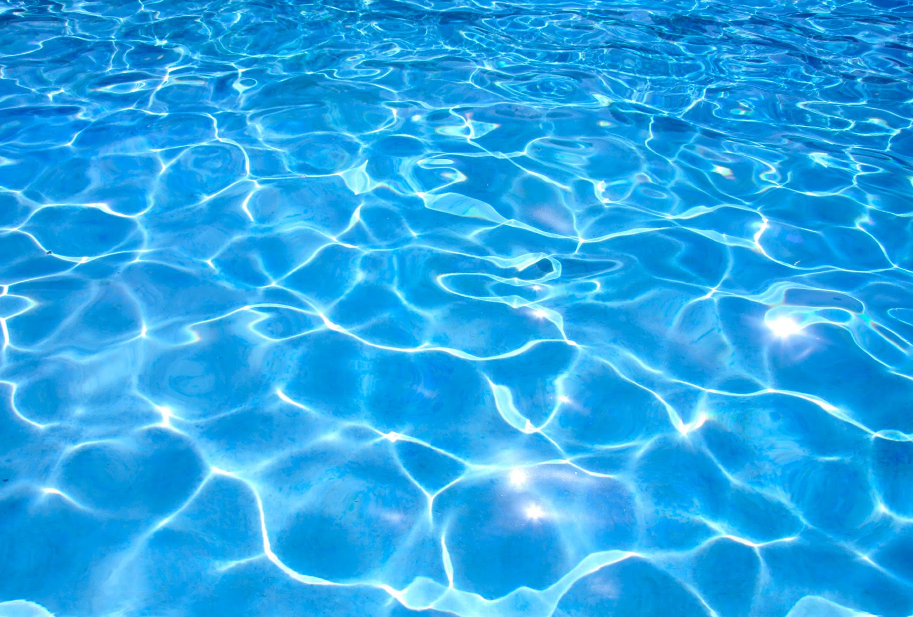
For all your eats and treats!
The Poolside
Thank you for visiting The Poolside. Our 2019 menu is listed on the following pages. You’ll find a wide selection of cold and hot beverages, delicious hot food items for a meal or snack, plenty of snacks and sweets, a selection of healthy choices and, of course, a wonderful ice cream assortment.
We look forward to serving you this summer! ☺
WE GLADLY WELCOME CREDIT CARDS WITH A 3% SERVICE FEE.

Slide 2
BEVERAGES
HOT FOOD
Water 1.25
Canned Drinks 1.25
Coke, Diet Coke, Sprite,
Lemonade, Seltzer
Gatorade 2.00
Snapple Iced Tea 2.25
Regular or Diet
100% Apple Juice Box 1.25
Hot Chocolate 2.25
With Whipped Cream
Hot Tea 1.75
Hot Coffee 2.25
Iced Coffee 2.50
¼lb Angus Beef Burger 4.00
¼lb dr. Praeger’s Organic Harvest Veggie Burger 4.00
Burger with Cheese 4.50
Chicken Nuggets 6 pcs 3.00
French Fries 2.75
100% All Beef Hot Dog 2.75
Burrito 2.75
Bean & Cheese, Beef & Bean
Hot King Size Pretzel 2.50
Grilled Cheese 3.00
Pizza when available 3.00

Slide 3
SNACKS & SWEETS
HEALTHIER CHOICES
Organic Hummus 2.25
With Carrots, Pretzels or Chips
Chobani Yogurt 2.25
Strawberry, Blueberry,
Peach, Raspberry
Nature Valley Oats ‘n Honey Granola Bar 1.50
String Cheese 1.00
Protein & Fruit Pack 2.25
Sharp Cheddar, Sea-Salted Cashews & Dried Cranberries,
White Cheddar, Sea-Salted Almonds & Dried Cranberries
Hot King Size Pretzel 2.50
Cup a Soup 1.75
Fresh Popped Popcorn 1.75
Chips & Crackers 1.00
Potato Chips, Cheetos,
Doritos, Fritos, Pretzels, Animal Crackers
Sweets 1.50
Sour Patch Kids, Skittles,
Kitkat, Oreos, Lorna Doone Shortbread Cookies
Ring Pop 1.25
Air Head 0.50, 3 for 1.00
Hot King Size Pretzel 2.50
Cup a Soup 1.75
Fresh Popped Popcorn 1.75
Chips & Crackers 1.00
Potato Chips, Cheetos,
Doritos, Pretzels, Fritos, Animal Crackers
Sweets 1.50
Sour Patch Kids, Skittles,
Kitkat, Oreos, Lorna Doone Shortbread Cookies
Ring Pop 1.25
Air Head or Sour Twist 0.50, 3 for 1.00

Slide 4
ICE CREAM
Chocolate Chip Cookie Sandwich 3.00
Vanilla King Cone 3.00
Cookies n’ Cream Avalanche 10 oz Cup 3.00
Dolly Madison Ice Cream Sandwich 2.50
Choco Taco 3.00
SpongeBob SquarePants Popsicle 2.50
Minion Bar 2.50
Frozfruit Chunky Strawberry 2.50
Red, White & Blue Popsicle 2.50
Rainbow Pop-Up 2.50
Lemon Marinos Italian Ice 2.50
Cherry Marinos Italian Ice 2.50
Creamy Krunch 2.25
Rich Bar 2.25
Orange Cream Bar 2.25
Popsicle Snow Cone 2.50

